Slide 1
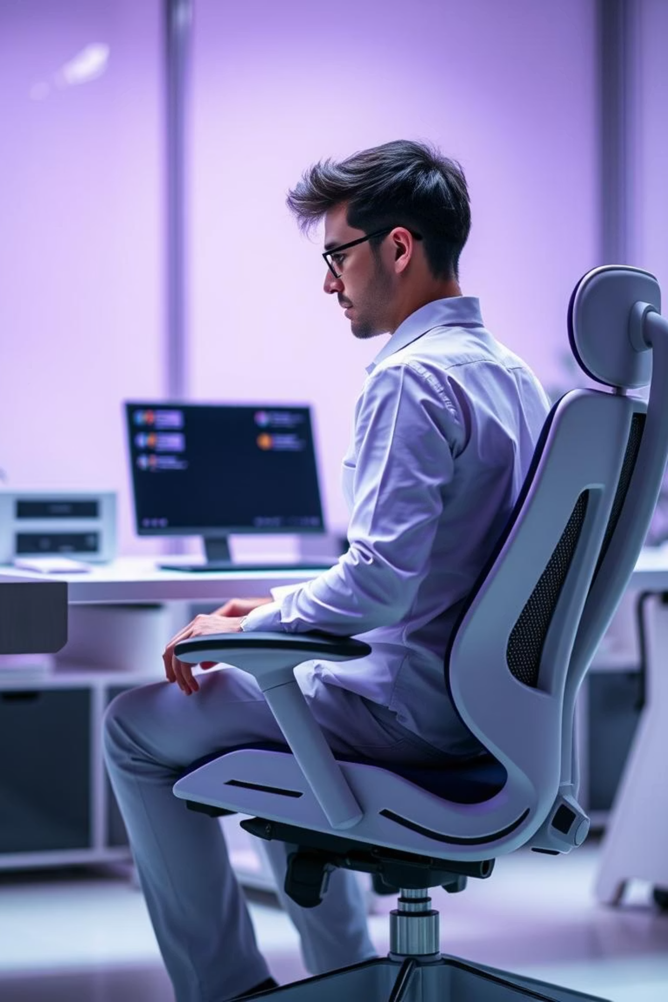
Ohmies: Smart Posture Monitor
Welcome to Ohmies! We're excited to introduce our innovative solution for better posture. Our smart monitor aims to enhance well-being for office workers and students alike.

Slide 2

Meet the Ohmies Team
Aarnav Rao
Antara Prabhune
Sooryakanth Ramakrishnan
Electronics and Sensor Integration
Software and User Experience
Hardware Design and Manufacturing

Slide 3
Our Core Idea: Smart Posture Monitor
Concept
Benefits
Technology
Wearable or chair-attachable sensor. It gently buzzes on poor posture.
Prevents long-term spinal issues. Crucial for students and tech workers.
Utilizes IMUs, flex sensors, and haptic feedback.

Slide 4




Current Market: Wearable Posture Devices
Upright Go / 2
Small puck-like Bluetooth wearable. Detects slouching with accelerometers and gyros. Provides vibration feedback.
LumoBack / Lift
Sensor belt or clip-on unit. Measures pelvic/spine angle. Offers gentle vibration alerts. Data viewable via smartphone.
iPosture Monitor
Pendant-like device with proprietary WINS sensors. Detects "ideal posture." Delivers vibration alerts for correction.
These devices highlight existing interest. They show potential for wearable solutions.

Slide 5




Beyond Wearables: Smart Seating & Sensors
Smart Chair Systems
Pressure sensors in cushion. PPG heart rate detection. ML classifies posture with high accuracy.
Smart Cushion Systems
Six flex sensors in cushion. Arduino and Node-RED integration. Smartphone notifications for posture.
E-Skin Neck Sensors
Flexible electronic skin for neck. Monitors flexion and lateral bending. Provides vibrotactile alerts.
These systems show diverse approaches. They inspire our comprehensive design.

Slide 6
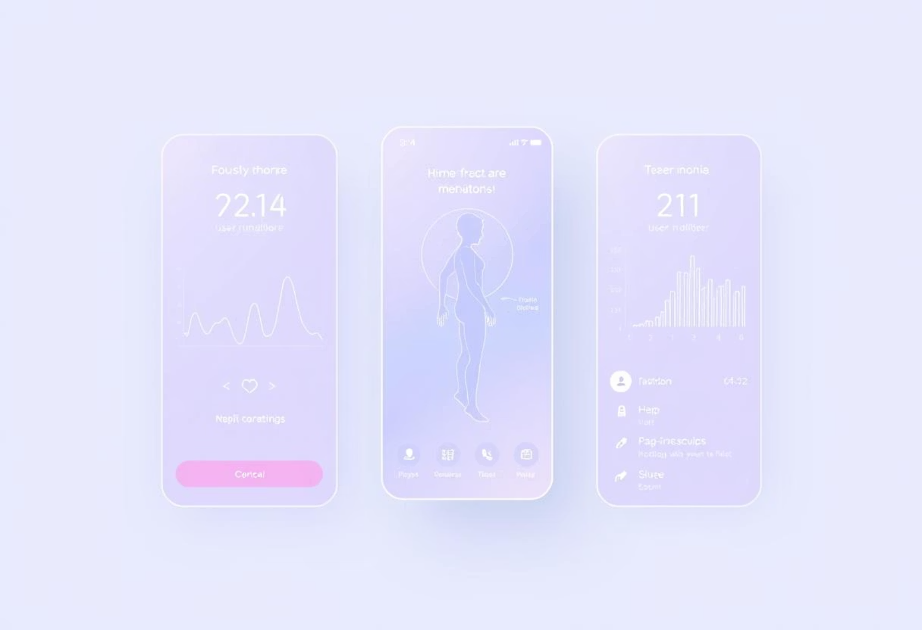
Ohmies' Unique Value Proposition
Multi-sensor Integration
Combines IMUs and flex sensors. Offers precise posture analysis.
Adaptive Feedback
Customizable haptic alerts. Reduces user disruption.
Versatile Application
Wearable or chair-attachable. Suits diverse user needs.
User-Centric Design
Focuses on comfort and long-term adherence.

Slide 7

Preliminary Implementation Approach
Data Processing Unit
Sensor Module Design
Select low-power SoC (e.g.,esp32). Implement real-time posture algorithms.
Develop compact IMU and flex sensor array. Ensure comfortable form factor.
Mobile App Development
Haptic Feedback System
Create intuitive UI for settings and progress tracking. Bluetooth LE connectivity.
Integrate miniature buzzer. Fine-tune alert patterns.
Our agile approach ensures rapid prototyping. We prioritize user testing.

Slide 8
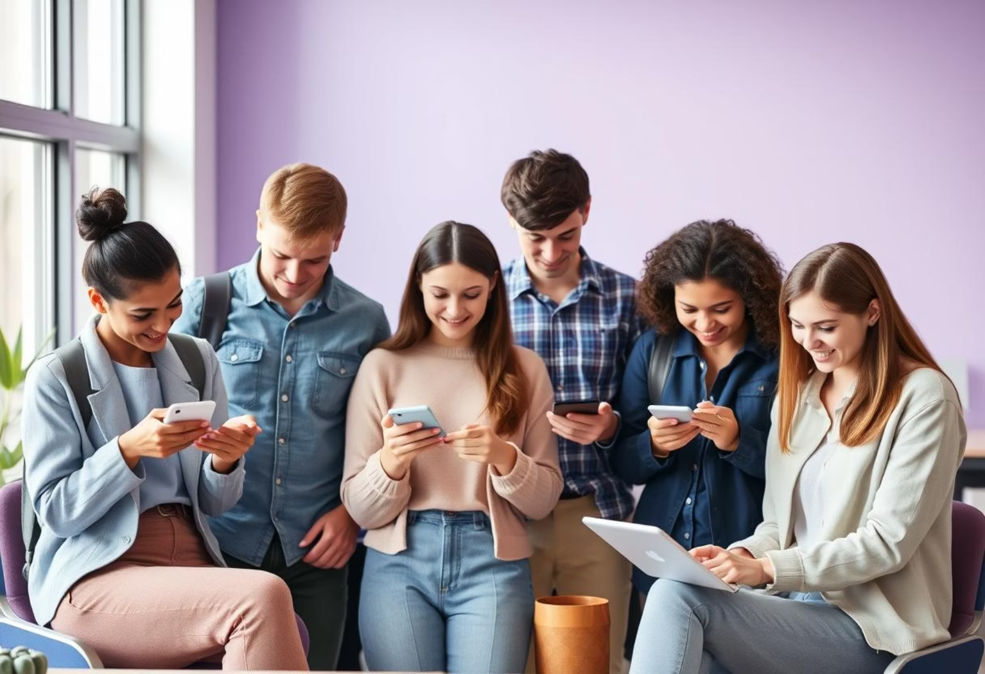
Market and Usage Projections
Primary Target
Office workers: Reduces strain from prolonged sitting. Improves focus.
Secondary Target
Students: Fosters healthy habits early. Supports academic performance.
Usage Model
Daily posture correction. Builds muscle memory over time. Enhances well-being.

